Slide 1
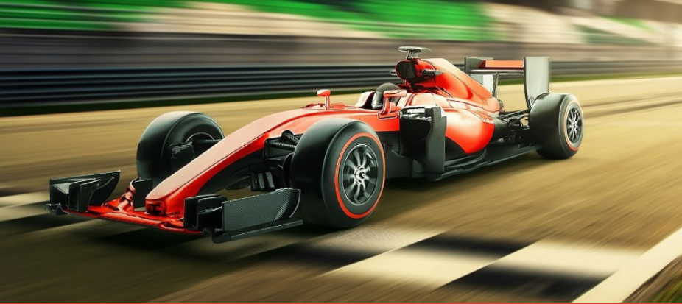

Formula AI Hackathon 2022
Formula 1 2021 Weather Data for the Formula AI Hackathon '22 - Challenge 1

Slide 2
Introduction
Formula 1 is one of the most competitive sports in the world. It is the highest class of international racing for open-wheel single-seater formula racing cars.
Engineers and technicians from every team use weather radar screens, provided by Ubimet to the teams, which allows them to track the current weather and make predictions during the race.
01
02
03
04

Slide 3
Problem Statement
F1 2021, the official Formula 1 videogame developed by Codemasters, uses a physics engine that behaves like the real world.
Points, and even races sometimes, are won and lost based on making sense of what the weather is going to do during a race, and being prepared as a team to act accordingly. Therefore, weather forecasting takes a big part on the possible outcome of a race.
01
02
03
04

Slide 4
Objective
We will develop an Artificial Intelligence model that is able to make accurate weather predictions / forecasts with using historical weather data from the RedBull Racing eSports team.
Indicate the predicted weather type at 5, 10, 15, 30 and 60 minutes after a timestamp, and the rain percentage probability at that time.
01
02
03
04

Slide 5
Data
Historical weather data from the RedBull Racing eSports team. It contains one or many weather forecast samples, up to 56. This depends on the duration of the race / grand prix where the data was recorded.
We have 58 input features for each sample.
01
02
03
04

Slide 6
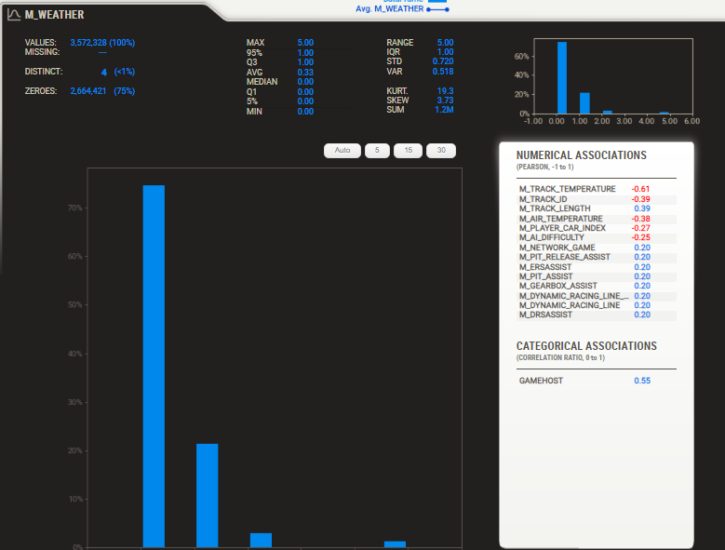
Data Analysis
01
02
03
04

Slide 7
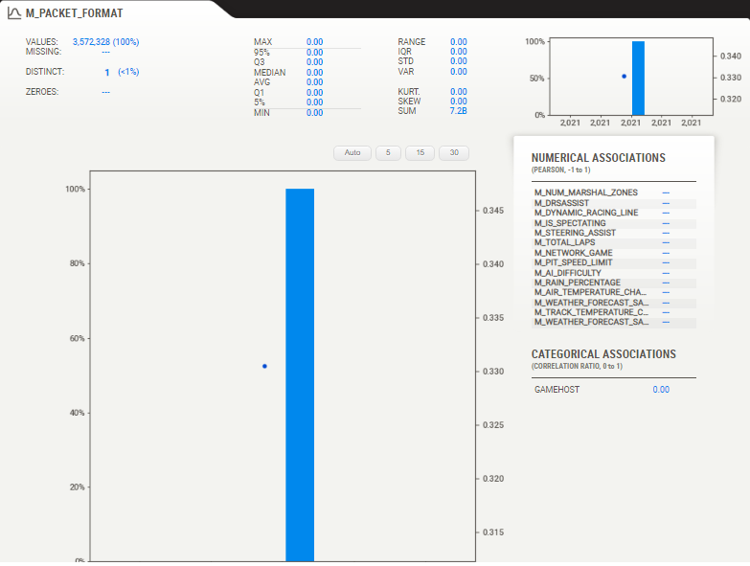
Data Analysis
01
02
03
04

Slide 8
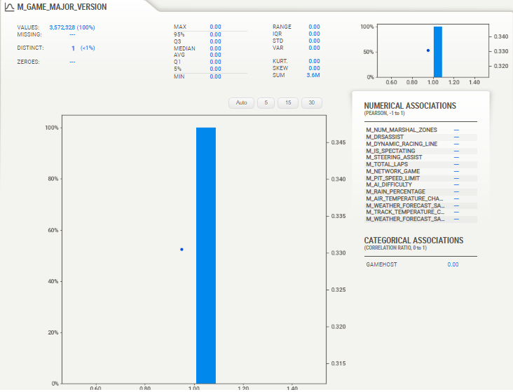
Data Analysis
01
02
03
04

Slide 9
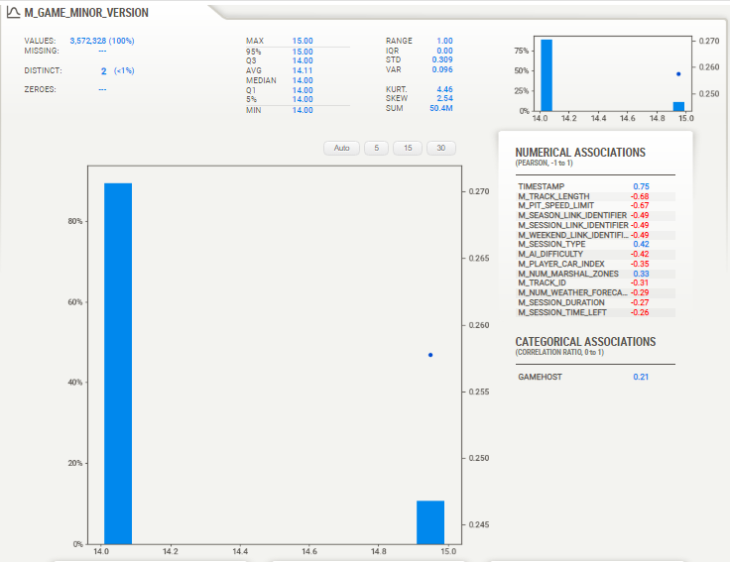
Data Analysis
01
02
03
04

Slide 10
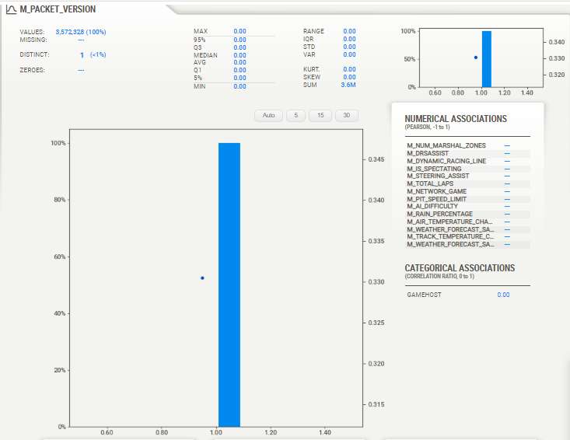
Data Analysis
01
02
03
04

Slide 11
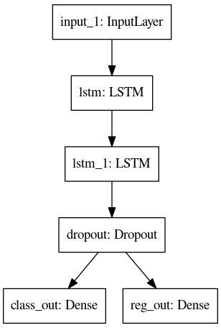
Time Series Modeling
01
02
03
04

Slide 12
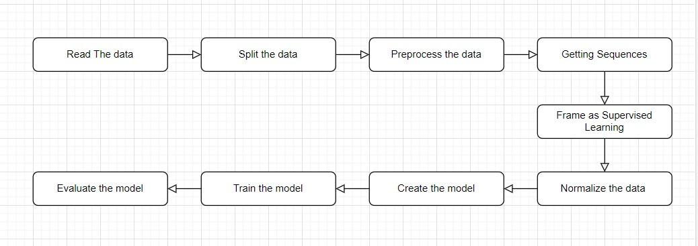
Model Structure
01
02
03
04

Slide 13
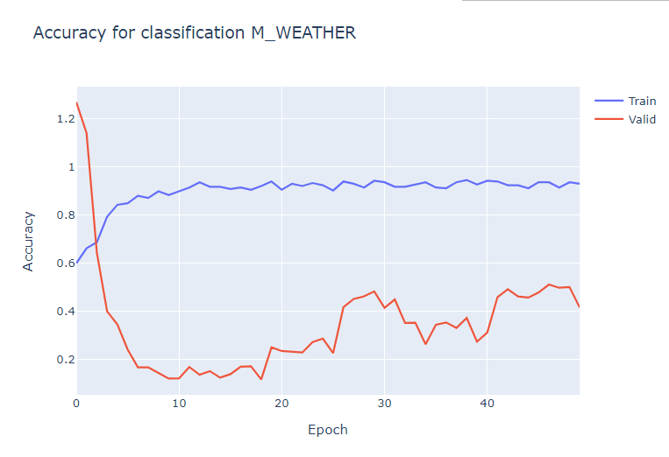
Results
01
02
03
04

Slide 14
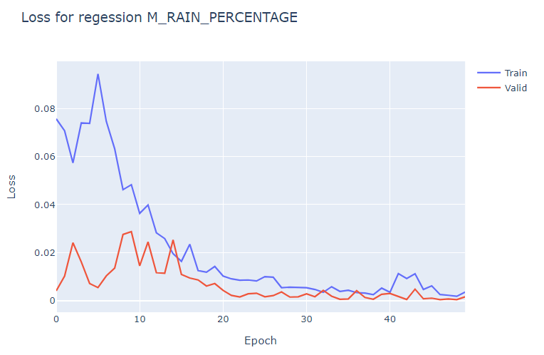
Results
01
02
03
04

Slide 15




Used Tools
01
02
03
04

Slide 16
Team members
Afnan Hamdy
Ali Hassanin
Aya Abd Elmonem
Mohamed ElMesawy
Mohamed Samaha
Rawan ElMahalawy
Thank You..!

